Slide 1
“THIS MEETING WILL COME TO ORDER”
Parliamentary Procedure
Optimist International
Notes:
The instructor’s function in this workshop is to help the participant retain as much pertinent material as possible.
Refer to NOTES TO THE INSTRUCTOR on page 1 of the Instructor’s Workbook for important information before presenting this workshop.
Take this opportunity to introduce yourself and establish your credibility for the subject matter with a short overview of your past/current leadership positions in your Optimist and everyday life.
You will need the following materials for each participant:
Participant’s Workbook
Set of your club’s bylaws (or set for self and each participant)
Set of Optimist International bylaws
Copies of Script Activities page 14c, pages 27 d-f
Optional: copies of the Chart of Motions on page 26
Copy of the Optimist Creed for each participant.

Slide 2
THIS MEETING WILL COME TO ORDER!
Goals of Program
Overview
Types of Assemblies
Basic Principles of Parliamentary Procedure
Kinds of Rules
Optimist International
Notes:
This slide gives an overview of the workshop.

Slide 3
GOALS OF PROGRAM
Understand the basic concepts
Develop sufficient skills in making motions, reports and problem solving.
Enable member’s full participation in business meeting
Optimist International
Notes:
Objectives of this module

Slide 4
WHAT WILL WE COVER?
Definition
Basic Principles
Motions
Voting Methods
Agenda
Optimist International
Notes:
The slide provides the basic agenda

Slide 5
PARLIAMENTARY PROCEDURE
The objective of parliamentary procedure is to insure the right of the minority to be heard but serve the majority opinion.
Optimist International
Notes:
Ask participants to turn to page 1 in their Participant's Workbook.
Many perceive parliamentary rules as the convoluted perversion of a few knowledgeable, strong-minded, and parliamentary-savvy individuals.
When this module is completed, the objective of parliamentary procedure will be better understood.

Slide 6
PARLIAMENTARY PROCEDURE
Set of finite rules
Covering set of circumstances
Not arbitrarily set
Evolved since 5th Century
Establish an order, fair approach to decision makings
Universally recognized
Optimist International
Notes:
This slide gives module definition of Parliamentary procedure

Slide 7
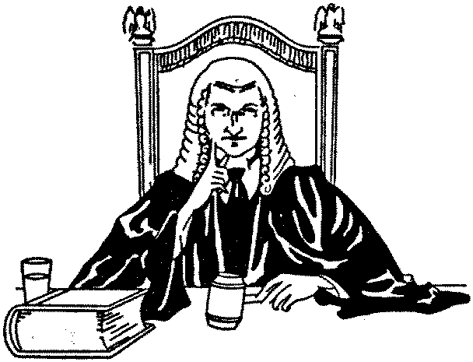
FOREMOST AUTHORITY
ROBERT’S RULES OF ORDER
All rules discussed in this module can be found in Robert’s.
Optimist International

Slide 8
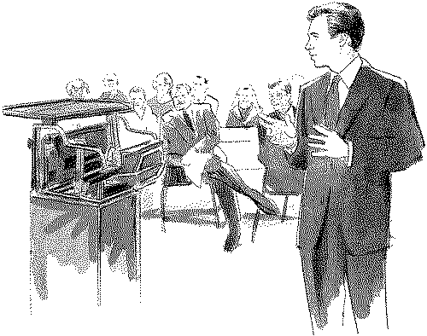
TYPES OF ASSEMBLIES
Mass Meetings: accomplish goals & objectives
Legislative bodies: enact laws
Conventions: meetings of delegates
Established organizations
Optimist International
Notes:
Refer participants to page 2 of their workbook.
The purpose of this section is to provide a perspective of parliamentary rules and their wide application.
Cover the main points.
Encourage participants to use the Notes column in their workbook.

Slide 9
BASIC PRINCIPLES OF PARLIAMENTARY PROCEDURE
Consider one thing at a time
Ensure justice, courtesy and equal treatment to all members
Serve the will of the majority
Preserve the right of the minority to be heard.
Optimist International
Notes:
Participants’ Workbook page 3
These principles are the underpinnings of democracy and need to be covered and understood, but should also take very little time.
The four slides that follow cover each of the four basic principles.
Use your own examples to clarify points as needed.

Slide 10
CONSIDER ONE THING AT A TIME
Most recently made motion is the immediately pending question
Only one to occupy current discussion
Optimist International
Notes:
Basic Principle No.1 – Consider one thing at a time.
A number of motions may be pending (ex: main motion and several amendments).
Only the most recently made motion is the immediately pending question to be discussed and considered.

Slide 11
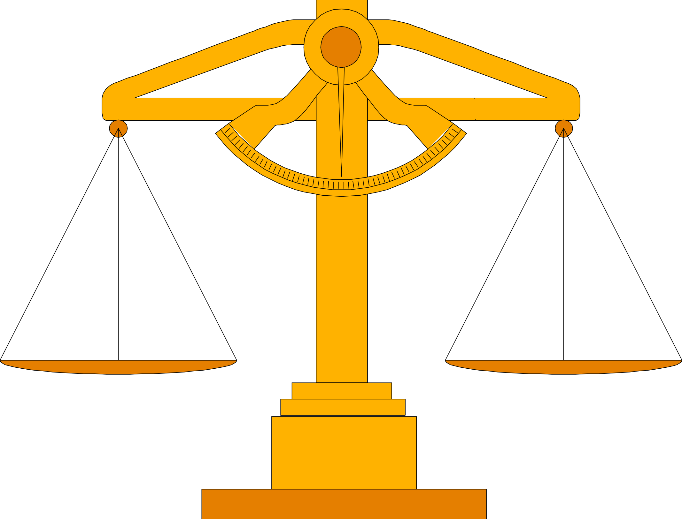
Ensure Justice, Courtesy and Equal Treatment to all Members
Basic rights and privileges of membership
Courteous and polite manner
Ample opportunity for an effective expression of opinion
Optimist International
Notes:
Basic Principle No. 2 – Ensure justice, courtesy, and equal treatment to all members
Do not lose control of the meeting; follow the basic rules.

Slide 12
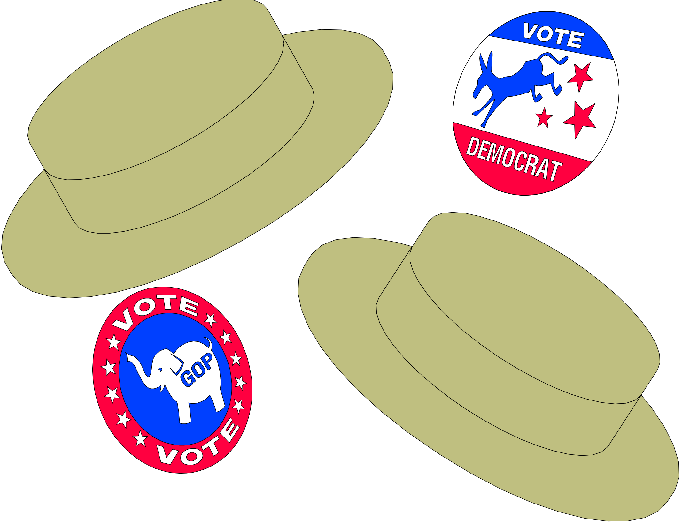
Serve the Will of the Majority
Majority Rule:
Most basic tenet of democracy
Optimist International
Notes:
Basic Principle No. 3 – Serve the will of the majority.

Slide 13
Preserve the Right of the Minority to be Heard
Safeguard the right of the minority to be heard
guard the minority opinion
right to full expression
Optimist International
Notes:
Basic Principle No. 4 – Preserve the right of the minority to be heard.
Again, do not lose control of the meeting; follow the basic rules.

Slide 14
OVERVIEW OF RULES
Laws of the Land
Corporate Charter
By Laws
Policies
Convention Standing Rules
Parliamentary Procedure
Optimist International
Notes:
Continuing on page 4 of the Instructor’s Manual.
Refer participants to page 4 of their manual.
This slide gives an overview of the rules to be covered.

Slide 15
KINDS OF RULES – cont’d
Laws of the Land
Paramount rules that govern us
May not enact rules which violate civil law
Corporate Charter
Names organization
Clearly states objectives
Optimist International
Notes:
Continuing on page 4 of the Instructor’s Manual
Refer participants to page 4 of their manual.
Work through all this material in the context of your club’s and Optimist International’s bylaws.
You may want to refer to them occasionally to see what they say on particular matters.

Slide 16
KINDS OF RULES – cont’d
By Laws
Sets limits
Officers’ and committee duties
Chain of command
Notice well in advance to amend
May never be suspended
Optimist International
Notes:
Ask for show of hands who has seen their club bylaws
Incumbent on members to know the rules
Bylaws and parliamentary authority are where members find parameters for elections, nominations, and jobs to which they may be assigned.

Slide 17
KINDS OF RULES – cont’d
Policies
Day to day administration
More easily amended
Convention Standing Rules
Specifically designed to make the business of the delegates run smoothly
Parliamentary Procedure
Rules that speak to the mechanics of a business meeting
If bylaws and policies are silent on a subject, then Parliamentary rule prevails
Optimist International

Slide 18
DECORUM
Established practices and customs for procedure
How we conduct ourselves at meeting
What we say when and to whom
Optimist International
Notes:
Bottom of page 4
We now transition from rules to decorum, or how to conduct themselves properly in a meeting.
Proper decorum avoids many problems.
In an international convention setting, formal decorum is expected at all times.

Slide 19
DECORUM - Examples
Remarks by members are made by and through chair
Only one person occupy the floor at a time
Can only claim floor if assigned by presiding officer
Show courtesy for an office; use of titles
Optimist International
Notes:
When another has the floor, it is incumbent on every member to listen attentively and refrain from conversation.
Enrichment activity offered with regard to Terminology.
Participants may keep a running glossary of specific words as you progress through this material.
Glossary available in the back of Goers’ Guide to Parliamentary Procedure

Slide 20
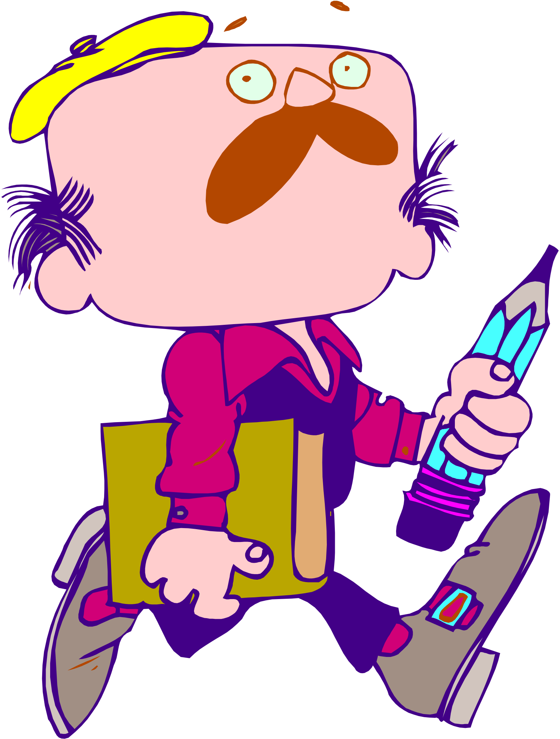
LET’S REVIEW
Not a Test
Exercises to help you remember the material
Complete the Review on Page 6.
Optimist International
Notes:
The Let’s Review is an enrichment activity that will reinforce learning.
Refer to the Instructor’s Notes on page 5 of your manual.
Read through the instructions with the group and determine whether to work as a group, subgroups or individually on this part, and check the answers together.
Refer to page 6a of the Instructor’s Workbook for answers to the exercise.

Slide 21
MOTIONS
Main Motion: Mechanism to introduce business for consideration
Optimist International
Notes:
Refer participants to page 7 of their workbook.
Now that some of the basics have been discussed, it is time to discuss some of the procedures.
Let’s talk about MOTIONS: what to do, what to say, when to say it and how to say it.
Topic is not in order to be discussed unless it has been properly introduced by a motion.

Slide 22
ANATOMY OF A MOTION
Member Receives Recognition
States the Motion
Another member seconds the motion
Chair states the Question on the Motion
Members Debate the Motion
Chair Puts the Question
Chair Announces the Result
Optimist International
Notes:
Knowing how to offer a motion properly is valuable and can be an advantage over those who do not know.

Slide 23
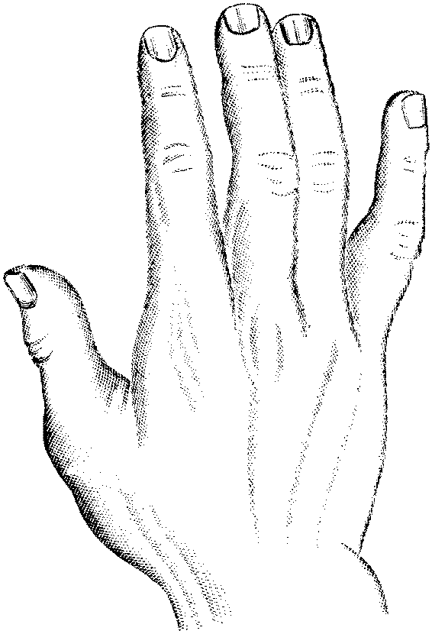
RECEIVE RECOGNITION
From the meeting Chair
Chair will assign you the floor
Large meeting/convention
Queue up at a microphone
Check if pro and con are designated
Smaller meetings – raise your hand
Optimist International
Notes:
When the Chair assigns the floor he/she tries to be impartial and fair.
Tries to assign the floor to opposing views alternately
Easier at convention where pro and con microphones are assigned
Not as easy at individual club board meeting

Slide 24
STATE THE MOTION
I move that …
Begin with “I move that . . . “
Conclude with exact wording of your motion
Straightforward language
Stated in the positive
Contains only one proposal
Optimist International
Notes:
Continuing on Page 8 of Instructor’s and Participants’ Workbooks.
Knowing how to offer a motion property in a meeting is a valuable tool that sets the member apart from those who don’t understand the process which in some cases is just about everyone.
Do not say “I make a motion ..” It is physically awkward, grammatically incorrect, and therefore wrong.
The proper was is to say “I move that …”
Motion is stated in the positive so that members understand that a yes vote means they are in favor and a no vote means they are opposed to your motion
If your motion is long, write it out precisely and hand it to the chair or secretary so it may be recorded properly.
State motion with no debate; brief introductory explanation before offering motion is allowed
Time of motion is NOT the time to debate the issue
Maker of the motion has the right to speak first and last during the debate.
Maker may not speak against own motion, but if persuaded by debate, may vote against it.

Slide 25
ANOTHER MEMBER SECONDS THE MOTION
“Second” or ”I second the motion”
Without second, motion “dies for lack of a second”
Any comment about the motion is considered a second.
Member allowed to second a motion they oppose
Optimist International
Notes:
Refer to page 8 of Instructors’ Manual
Seconding a motion is so misunderstood. Stress the reasons as explained the the participant’s workbook.
Second lets the chair know that more than one person wants to spend the time of the group on discussing the issue.
Record second in minutes. Not necessary to record name of the maker.
A member will second a motion to which he is opposed for the very purpose of having the group decide the issue once and for all.
The member who seconds the motion may speak and vote against it.

Slide 26
CHAIR STATES THE MOTION
“It has been moved and seconded that we . . . (stating the motion’s exact words) Is there any discussion? ”
Handling the Main Motion:
Postponing it
Refer it to Committee
Amend it
Optimist International
Notes:
Continuing with page 8:
At this point, and not before, the motion becomes the property of the group and only the group can dispose of it.

Slide 27
EXAMPLE OF A PROPERLY STATED MOTION
“I move that we operate a concession stand at all home games to benefit the marching band’s Uniform Fund”
Optimist International
Notes:
This is an example of a properly stated motion.
Resolutions are included here purely for the sake of thoroughness.
Occasionally members want to draft a formal resolution so here is a sample.
A resolution is the same as a main motion except that it is always written out in a series of resolved clauses and often contains some pertinent debate in a preamble consisting of whereas clauses.
Resolutions by town or state governments are encouraged to recognize special Optimist activities such as Youth Appreciation Week.
There is not need to spend much time on this unless someone is particularly interested.
Same motion in resolution form is presented on page 9 of Instructor’s and Participants’ Workbooks.

Slide 28
MEMBERS DEBATE THE QUESTION
Members may fully express their opinions.
Members need to understand the rules of debate.
Motion to Limit or Extend the Limits of Debate.
Can’t yield unexpired time.
Direct all discussion to the Chair.
Appropriate time for motions that will improve or dispose the existing motion.
Optimist International
Notes:
Page 9 continued
General rule of debate: each member may speak twice, for 10 minutes, to each motion, but may not speak a second time until all members who wish to have spoken once.
At the Optimist International convention, members are limited to 2 minutes. This is also a good guideline if meeting time is limited.

Slide 29
DEBATE TIPS FOR THE CHAIR
When presiding over Debate
Alternate pro and con
Courteous to everyone
Be sure precise question is known
Rules of time and decorum
Be sensitive to group wishes
Be ready to put question to a vote as soon as group is ready
Optimist International
Notes:
Refer to page 10 of Instructor’s Manual.
Make sure everyone understands the correct wording.
Rules of debate are for protection of the assembly. Rules should be enforced gently but firmly and always with courtesy.
Votes have been lost because a president didn’t understand when the group was ready to vote and didn’t take the time to vote in time.
Techniques to “nudge” the members along to a vote.
Ask, “Is there any NEW information to come before us on this issue?”
Chair can say, “Are you ready for the question?” Many members may feel this question means they have to stop talking and vote.
If a member says, “No! I want to say something else.” then debate continues.

Slide 30
CHAIR PUTS THE QUESTION
No further discussion
Put Question to Vote
Repeat motion clearly
Give precise instructions
Announce results in 3 ways:
“The yeses have it, the motion carried, and the Concession Stand Committee is ordered to begin work on this project.”
Optimist International
Notes:
Refer to page 10 of Instructor’s Manual.
“The question before us is that we will operate a concession stand at all home games and donate the proceeds to the marching bank’s Uniform Fund. As many as are in favor of this motion say ‘yes’ (pause). Thank you.” “As many as are opposed to this motion say ‘no’ (pause). Thank you.”
Or “The noes have it, the motion is lost and we will not operate a concession stand at home games.”
The chair has maximized everyone’s clear understanding of what happened.
Even if unanimous, the chair should always ask for the note vote.
Don’t say “those opposed, same sign.”

Slide 31
VOTING METHODS
Voice Vote
Show of Hands
Rising Vote
Roll Call
Ballot
General Consent
Mail or Proxy vote
Secretary to cast one ballot
Optimist International
Notes:
Refer to pages 11-12 of the Instructor’s Workbook
Voice Vote: Most often used; asking members to say yes or aye if they favor a proposal or to say no or nay if they are against.
Show of hands small groups where everyone can be seen, members asked to raise their hands to indicate their preference on the proposal
What’s Wrong with this Picture? ( on page 11) Man in the back row is voting twice. He might get away with it in a crowd, which is why we take a rising vote in a large group. The woman in the front row is abstaining from voting which is her right. No one can be compelled to vote. But no one is entitled to more than one vote.
Rising Vote: when 2/3 vote is required, used to verify vote when a member doubts the results and calls for a Division of the Assembly
Roll Call: verifies attendance and records how each member votes
Ballot: by paper or machine, keeps voter’s choice a secret. The chair may vote when the vote is by secret ballot since how he votes can not unduly influence others.
General Consent: voting on routine matters (approval of minutes) The members agree to an action by keeping silent and not raising an objection. Used in a Consent Agenda. Danger of new presiding officer may over use it and/or use at inappropriate times. Defense against is the members’ knowledge that they can object to General Consent and thereby force a vote.
Mail or Proxy and Secretary to cast one ballot: must be authorized in the bylaws.

Slide 32
VOTING TYPES
Majority: Any number greater than half
2/3 Vote
Plurality: largest number of votes to be given any candidate or proposition when 3 or more choices are possible; never elects unless bylaws authorize
Tie Vote: Equal number for and against; motion is lost; Chair can vote to break a tie, or vote to create a tie.
Optimist International
Notes:
Instructor’s Workbook Pages 12-13.
The general rule, unless the bylaws say otherwise, is that a majority is any number greater than half of those present and voting.
Note that the OI Bylaws say about the International Board of Directors’ meetings that “. . . A majority of those present and entitled to vote shall be necessary to give effect to any action of the Board.” This is a case of the bylaws superseding parliamentary law. Think about the impact of requiring a majority of those present and choosing to vote against requiring a majority of those present and entitled to vote. In the first method abstentions are not counted. In the second method, abstentions are counted, which changes the number required to carry a motion. Neither method is wrong, they are just distinctly different.
When a 2/3 vote is required on a motion, as it is to Limit Debate and to Call the Question, it means that someone’s rights are being infringed upon in some way. In these cases it would be the basic right to full and free debate.

Slide 33
LET’S REVIEW
Not a Test
Exercises to help you remember the material
Complete the Review on Page 14.
Optimist International
Notes:
Refer to page 14 and 14A of Instructor’s Manual.
Extra Script Activity “Processing a Motion” is available on page 14b & c of the Instructors’ Workbook and may be used at this point.

Slide 34
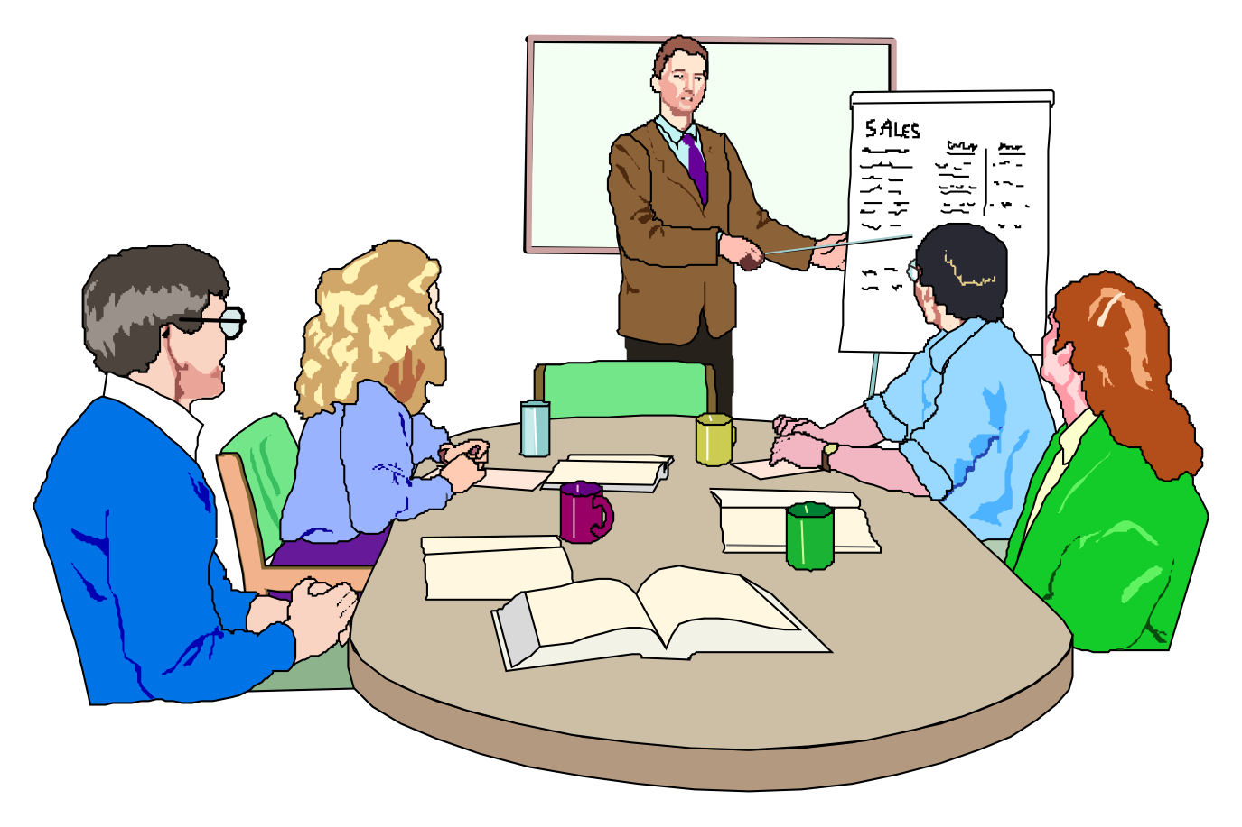
AGENDA
Plan
Lay out clear goal
Order of business to be followed
Prescribed in parliamentary authority
Optimist International
Notes:
Refer to Instructor’s Workbook Page 15
Ask participants to turn to page 15 of their manual.
The agenda shown here is the generic variety found in major parliamentary authorities.
Each group will tailor the basic agenda to meet the needs of the groups in any particular meeting.
We will also use the agenda to explain the most pertinent details of a meeting and how to handle them.

Slide 35
AGENDA – Cont’d
Call to Order: after determining a quorum, rap of gavel, announce “The meeting will please come to order.”
Minutes: Pause after announcing the item to allow for reaction by members.
“Hearing no correction, the chair declares minutes approved.”
Correspondence: Not listed in Robert’s but often necessary.
Optimist International
Notes:
The gavel is a symbol of authority. Use a light tap of the gavel to bring the members to order and adjourn and otherwise leave it lay on the podium.
Minutes: Refer to page 17 Instructor’s workbook, and Participant’s Workbook for in-depth look at “Contents of Minutes.” This can be used as a reference page and, depending on time available, does not have to be covered in detail.
A savvy presiding officer often moves the organization along with the momentum of his own energy and enthusiasm.
Each meeting should be planned from beginning to end with an eye to motivating and encouraging members to fully and willingly participate
In other words, effective meetings don’t just happen all by themselves – they take planning and leadership.
A presiding officer needs to consider what words he will say at every pivotal juncture in the agenda.
When he announces the vote on a motion, what will he say next? He will say, “The next item on the agenda is. . .”
The chair should know which committee chairmen have reports and he should not waste time calling on those who don’t.
The chair should never ask if there is any unfinished business.
If the premier leader of the group doesn’t know what business is unfinished the group is in big trouble. The chair simply brings up each item of unfinished business, if there is any and then says, “There being no further unfinished business, is there any new business to come before us at this time?”

Slide 36
AGENDA – Cont’d
Treasurer’s Report: Requires no vote
Given for information only.
Executive Board and Officers’ Reports
Standing & Special Committee Reports: statement agreed upon by a majority of the committee.
Special Orders: business items postponed to a specific time in a meeting.
Optimist International
Notes:
Instructor’s Workbook Page 18
Treasurer’s Report: Treasurer reports the balance on hand as of last report, total receipts and total disbursements since last report and current balance. This balance is all that needs to be reported in the minutes.
A committee can spend more time looking at a subject in-depth and has more freedom to explore all the options than is possible in a larger group. When the committee decides on its recommendation to the membership, it should also draft a motion to implement that recommendation and be prepared to make the motion at the conclusion of the report. Never rely on the general membership to figure out what, exactly, the committee wants done. Tell them in the motion and then let the membership make the final decision through deliberations and amendment.

Slide 37
AGENDA – Cont’d
General Orders: Items postponed to the next meeting
Unfinished Business: Items carried over from previous meeting
New Business: New subjects may be introduced in the form of a main motions.
Program: Some groups have entertainment or an educational program as a part of their meeting.
Optimist International
Notes:
Refer to page 20 of Instructor’s Manual.
Items of business are made general and specific orders by means of the parliamentary motion to Postpone to a Set Time.
Business may not be postponed beyond the next meeting in organizations meeting at regular intervals of weekly or monthly.
Items may also not be postponed more than three months.
If it is desired to carry over an item of business longer than a three months then the item should be referred to a committee with instructions as to when to reintroduce the subject.

Slide 38
AGENDA – Cont’d
Announcements: Notice of a member’s intention to offer a motion at the next meeting
Adjournment: No further business on agenda; no one is seeking the floor
President may tap the gavel and adjourn the meeting by saying, “There being no further business, this meeting is adjourned.” Motion is assumed.
Optimist International

Slide 39
LET’S REVIEW
Not a Test
Exercises to help you remember the material
Complete the Review on Pages 21 and 22.
Optimist International
Notes:
Refer to Instructor’s Workbook pages 21 and 22, same for Participants.
Review answers found on Instructor’s Workbook pages 22a and 22b.

Slide 40
LEADERSHIP OPPORTUNITIES
Best defense against one person’s personal agenda is knowing the rules.
Privileged Motions
Subsidiary Motions
Incidental Motions
Second Chance Motions
Page 24 and Page 26
Optimist International
Notes:
Refer Instructor’s Workbook page 23.
Summarize material in left column of page 23 of Instructor’s Manual.
Here we will take a basic look at the parliamentary motions so that you can have, at least, a modicum of understanding of what whey are used for and how you can make them work for your group.
The charts on page 24 contain legends which are self-explanatory. Below is a brief explanation of the purpose of each of these motions. Take the time to read the purpose of each motion and then consult the chart to see whether or not it needs a second, can be debated and amended and what vote is necessary for adoption
Review information on page 25 regarding ranking of motions.
Explain charts on page 26.

Slide 41
LET’S REVIEW
WHICH MOTION SHOULD I USE?
Provide the motion you think would best solve the problem.
Page 27
Optimist International
Notes:
Page 27 for Instructor and Participants
Ask participants to complete the review. Answers are on pages 27a and 27b.
Page 27d - f are an Extra Script Activities

Slide 42
TYPICAL GLITCHES
Can you solve the questions?
Optimist International
Notes:
Refer to pages 28 and 29 of Instructor’s Manual for answers to each question and the corresponding Instructor’s Notes.
Members who don’t know parliamentary procedures may have no idea how to remedy certain glitches that come up during meetings.
Read each question and determine the possible solution.
Refer to the Chart of Motions (handout or page 26) for possible solution(s).

Slide 43
WHAT DO YOU THINK NOW?
Questions?
Optimist International
Notes:
Conclude by stressing the usefulness of this PGI module for all club members.
Recommend this module become a prerequisite for all current and incoming Optimist leadership.

Slide 44
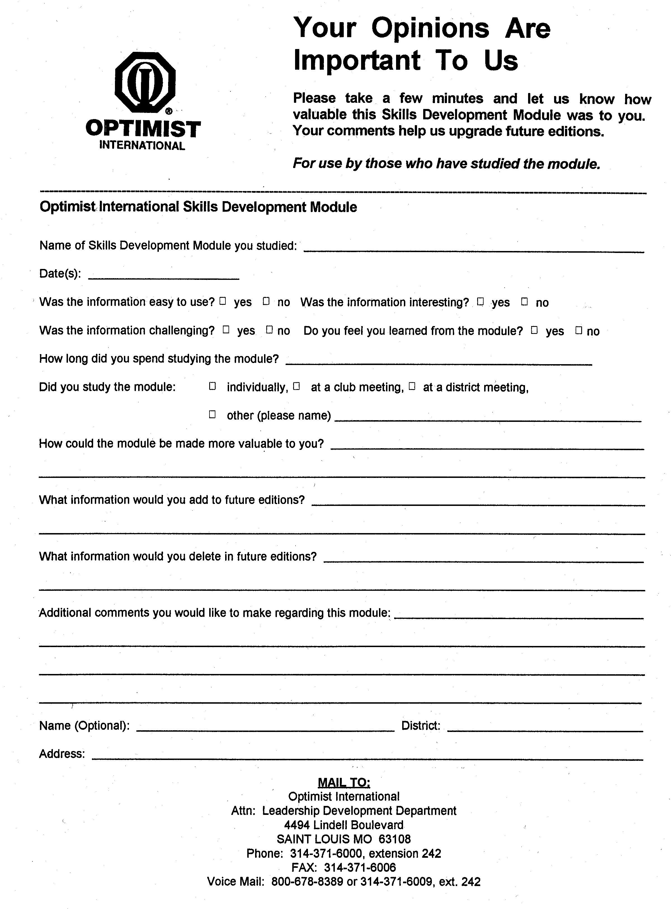
YOUR OPINION IS IMPORTANT
Optimist International
Notes:
Have participants complete the evaluation and encourage them to continue their education with other Skills Development Modules.
Conclude with the Optimist Creed (have copies handy for all).

